Slide 1
Product Recommendations using Body measurement
Project Reference No.: 47S_BE_0824
New Horizon College of Engineering
Artificial Intelligence and Machine Learning
Student(s) Name:
1. Mr. K Vamshivardhan (1NH20AI049)
2. Mr. Puneet Vernekar (1NH20AI082)
3. Mr. Rahul Ravindra (1NH20AI084)
4. Mr. Vignesh Bharadwaj (1NH20AI118)
Guide(s) Name:
1. Prof. Ramesh Prasad
2. Dr. Umamaheshwaran S.

Slide 2
OBJECTIVES
Accurate Body Measurement Extraction:
Accurately extract essential body measurements from user submitted images. Ensure precision and reliability in measurement extraction, compensating for variations in poses, camera angles, and clothing influence.
Personalized Product Recommendations:
Implement a recommendation engine that utilizes the captured body measurements to offer personalized and size-specific product suggestions.
User-friendly Interface:
Design an intuitive and user-friendly interface for users to easily upload photos for body measurement extraction. Provide real-time feedback on measurement extraction to enhance user experience.

Slide 3
METHODOLOGY
The system integrates cutting-edge technologies to provide precise body measurements and personalized clothing suggestions. It utilizes the SMPL model, a lifelike 3D representation of the human body, alongside shapes obtained from extensive 3D body scans. Furthermore, the Extended Kalman Filter (EKF) model improves pose estimation accuracy by refining linearized measurements. These elements work together to ensure accurate measurement extraction and thorough analysis.
Users have to submit front side image for detailed measurement examination, guaranteeing precision and comprehensiveness. User also need provide height and weight to get accurate body measurement. These measurements serve as the basis for tailored clothing recommendations that align with user preferences and current fashion trends.

Slide 4
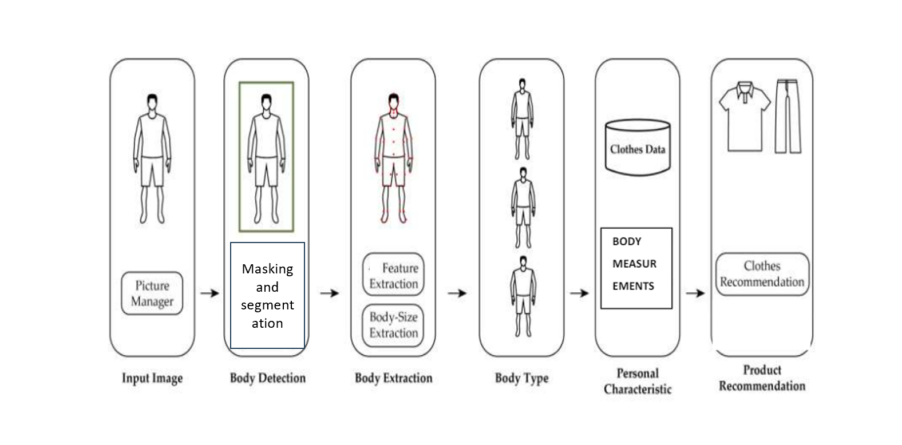
SUMMARY OF PROGRESS (DESIGN, EXPERIMENTS, RESULTS)

Slide 5
WORK PLAN
Image Processing: Recognize and locate key body landmarks in the user-uploaded photos. Implement computer vision algorithms, possibly leveraging deep learning models for landmark detection. Address variations in pose, lighting, and clothing obscuring body contours.
Mesh Creation: Perform the masking and segmentation process on the image and generate an 3D mesh of human body which resembles the actual figure of the human body and measurements. Based on the RGB-D data, define the depth of the body parts.
Measurement Calculation: Derive accurate body measurements from the generated mesh. We calculate measurements of the human body such as chest circumference, waist, arm, thigh, hip and leg length.
Data Retrieval: Utilize Rapid API to fetch product details, availability, pricing, and other relevant information necessary for building a comprehensive recommendation system.
Clothing Recommendation: Utilizing the extracted body measurements and user preferences, our model will recommend personalized clothing options, considering size compatibility.

Slide 6
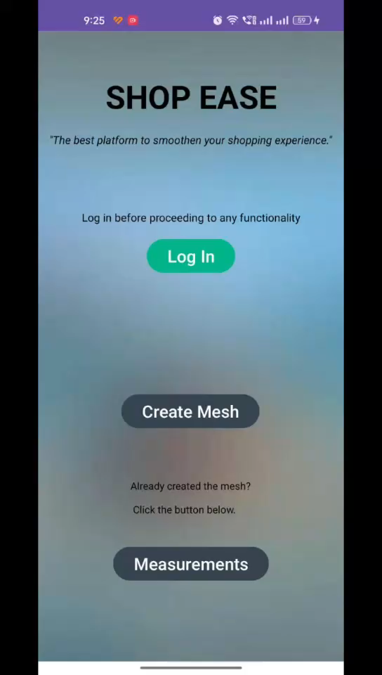
SUMMARY OF PROGRESS (DESIGN, EXPERIMENTS, RESULTS)
The above video shows the working of an app

Slide 7
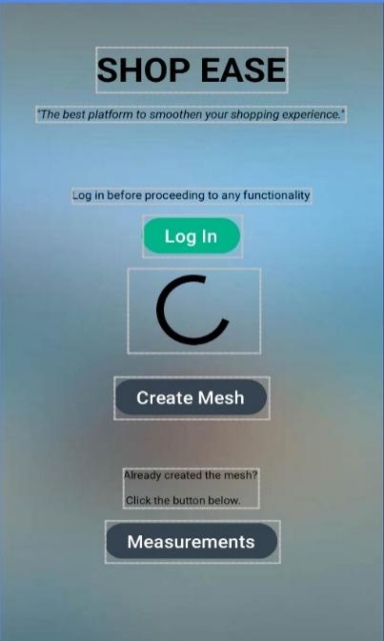

SUMMARY OF PROGRESS (DESIGN, EXPERIMENTS, RESULTS)
Log in screen to proceed with the creation of the mesh/ check measurements
Upload the image through camera or selection from internal storage

Slide 8
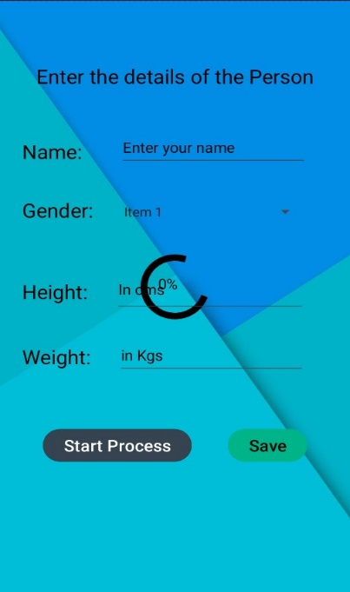
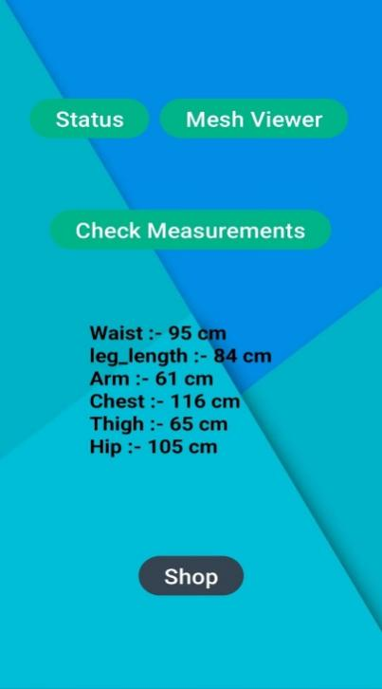
SUMMARY OF PROGRESS (DESIGN, EXPERIMENTS, RESULTS)
Enter the details of the user i.e., gender, height and weight
Check body measurements and move to mesh viewer

Slide 9
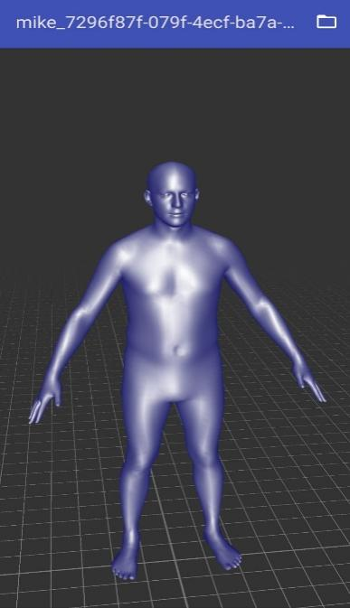
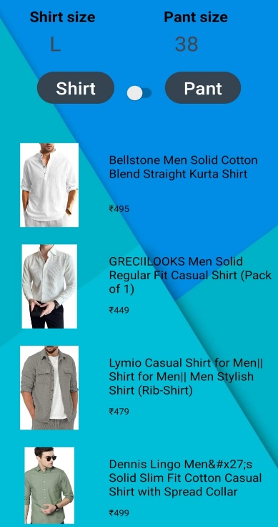
SUMMARY OF PROGRESS (DESIGN, EXPERIMENTS, RESULTS)
View the Human 3D mesh in Mesh Viewer
Buy clothes based on the perfect size recommended

Slide 10
SCOPE FOR FURTHER DEVELOPMENT
Looking forward, the project has promising opportunities for exploration is the enhancement of the virtual try-on feature. Utilizing emerging technologies like augmented reality (AR) and virtual reality (VR), we can develop more immersive and lifelike virtual fitting rooms. This might involve introducing functionalities such as precise body tracking to ensure accurate garment fitting.
Collaborations with fashion brands and integrating with a wider array of product catalogs, we can grant users access to an even wider selection of clothing items. Additionally, there's potential for exploring new segments within the fashion industry, such as accessories.

Slide 11
Thank You

